Slide 1
IPR Term 1 Week 4
Qualitative Research 2
Thematic Analysis
Dr Hayley Dewe
(Assistant Professor)

Slide 2
Announcements
SONA: max credit limit should now be removed (earn 10 credits for IPR, and anything extra will be left for your Year 3 Diss)
SONA: be keen, do it now if you have the time!
Alternative Assessment to SONA
(deadline tomorrow: 31st Oct)
Q&A drop in tomorrow (31st Oct)
Online content
Practical 2 (Goggles) is underway

Slide 3
Learning Outcomes
Understand what qualitative research is and its purpose
Learn key qualitative research methods
Understand how data is collected and analysed
Gain practical experience and knowledge on how to apply these methods
Today: specific focus on thematic analysis

Slide 4
Lesson Outline
This week, the lecture and online content will introduce you to…
Overview of Data Analyses
Discourse Analysis & Activity
Content Analysis & Thematic Analysis
Activities: Online content

Slide 5

1. data analysis techniques

Slide 6
RECAP LAST WEEK: Examples of Data Collection
Method | Type | Use (Example)
Case study |  | For an in-depth look at a complex, rare, or unique conditions/behaviours.
Interview | Structured | For broad, specific information (e.g., surveys, or for Quant)
 | Unstructured | For deep insights into personal experiences
 | Semi-structured | For understanding someone’s perspective (e.g. exploratory)
Focus Groups |  | For gathering community feedback, or for market or social research
Observation |  | For understanding behaviour / experience in natural environments / without manipulation
Ethnography |  | For exploring cultural practices, beliefs, norms of a specific group/community

Slide 7
RECAP LAST WEEK: Data Analysis
Thematic Analysis
To identify patterns or ideas across multiple data (e.g., interviews or focus groups)
Content Analysis
Analysing various sources of data (e.g., documents, text, media) to quantify findings (categorising and counting occurrences of themes/words)
Narrative Analysis
Examines stories from individuals to understand how they contrast meaning and identity through narrative
Grounded Theory
To develop a theory grounded in data collected
Discourse Analysis
To study language use and communication
Interpretative Phenomenological Analysis (IPA)
Lived experience of individuals

Slide 8
ACTIVITY 1
Comparing Quantitative and Qualitative
A (simplified) example
Suppose you wanted to investigate the current stress levels of undergraduate students…
Quantitative vs Qualitative
Work individually (and make notes) or in pairs (both answer in turn, make notes)

Slide 9
ACTIVITY 1
Comparing Quantitative and Qualitative
A (simplified) example
Suppose you wanted to investigate the current stress levels of undergraduate students…
Quantitative Method:
Questionnaire – items from State-Trait Anxiety Inventory Sub-scales:
- state (Y1): how anxious someone feels in the moment
- trait (Y2): how anxious someone generally feels)
Scores range from 20-80 on each sub-scale
*it’s not used as a diagnostic tool. High scores don’t confirm a diagnosis

Slide 10
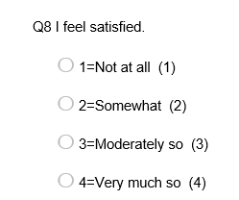
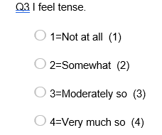
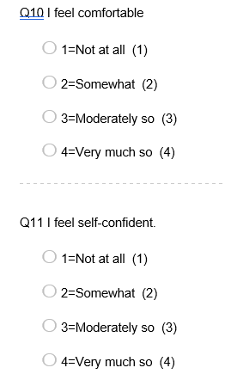
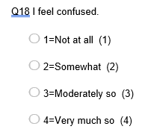
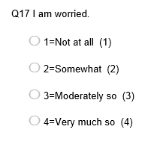
Quantitative (State items):
ACTIVITY 1

Slide 11
ACTIVITY 1
Qualitative (interview prompts):
Can you tell me how you've been feeling today in relation to your university life?
…with follow up questions / prompts..
What specific emotions or feelings have come up for you today?
Has anything in particular at university affected your mood today?
How have these feelings influenced your ability to focus or get things done?

Slide 12
ACTIVITY 1
Now you have your answers…
You should now have some numeric values (Quantitative) and some written text answering the interview questions (Qualitative)
Compare your two (very mini) data sets, thinking about…
Does the qualitative data provide context or explanations that the numbers alone cannot?
Which dataset is easier to interpret quickly? What are your interpretations of the data?
Which requires more time or skill to analyse meaningfully?
Which dataset provides a more accurate representation of your experiences and feelings?
How well do the responses from the interview data complement or align with the numeric data?
Did you respond differently to one format than the other? E.g., being asked interview questions vs a questionnaire?
Which format might introduce more bias (e.g., interviewer influence vs self-report scale)?
Which feels more reliable? As a researcher, which would you choose and trust more?

Slide 13
2. Discourse Analysis

Slide 14
Discourse Analysis
How language constructs reality
The implications of language conceptualises language as constructive or functional
What is said, how it is said:
Language itself
Syntax: arrangement of words to form sentences
Semantics: meaning of the words
Pragmatics: how context contributes to meaning
Various forms of communication:
Spoken language (e.g. conversations)
Written texts (e.g., social media posts)
How it reflects or challenges norms
Inferences on broader trends

Slide 15
Discourse Analysis
Last weeks online content introduced you to an example of Discourse analysis!
Studying language in two different excerpts
You were asked to read through the two different text extracts and work through the questions provided to start thinking about the language used and implications of text.
Several different approaches but largely include:
Define research question
Select/collect data – read and (and re-read)
Coding: code / select all potentially relevant references
Researcher interacts with and interprets

Slide 16
Discourse Analysis
Statement – sentences/phrases that convey key ideas/arguments relevant references
Structure – key sections / views / arguments – how it’s presented/organised
Language & rhetorical choices – e.g., emotional tone, metaphors)
Positioning & pronouns – “I” vs “We”, inclusion/exclusion strategies
Identity & Power – who created it & how identity and authority are constructed in the text
Ideology & Assumptions – values and beliefs embedded in text (norms, desirability, underlying messages)
Audience engagement – direct address, calls to action, emotional appeal
Intertextuality – connects to other texts/cultures/context (e.g. hashtags)

Slide 17
Excerpt 1: Political Speech
“We will not back down in the face of adversity. Together, we will stand united against those who seek to divide us. Our strength lies in our diversity, and we must embrace that diversity to build a better future for our children.”

Slide 18
Excerpt 2: Social Media post
“Just finished my workout at the gym! 💪 I really pushed myself today and can feel the difference. It’s rewarding to see progress, both in strength and energy. Working out has become a key part of my self-care routine, helping me clear my mind and boost my mood.
Today, I hit a new personal best on my squats, which feels amazing! Remember, every step counts in this #FitnessJourney. Self-care is about feeling good as much as looking good! Let’s keep motivating each other! 💖 #SelfCare #Motivation #HealthyLifestyle”

Slide 19
Discourse Analysis
ACTIVITY 2
If you have done the online activity from last week:
If you have NOT done the online activity from last week:
How did you identify power and ideology in the Political speaker's language?
How did the social media post reflect intertextuality? e.g., broader cultural discourses around wellness and self-care?
How did you interpret the author’s identity construction in each speech? What evidence did you use?
What kinds of questions or discourse features helped you uncover meaning in the texts?
Choose one text and note:
What are they trying to achieve? Key ideas (statement) or differences in language choice (e.g. tone)
Is there any emotionally charged or persuasive language?
Any marks of identity or power?
Any examples of audience engagement – i.e., direct address, calls to action or emotional appeal?

Slide 20
3. Content & Thematic Analysis

Slide 21
Content Analysis
Quantifies specific aspects / patterns (e.g., presence / frequency of words)
Codes – short phrases /words used by the participant
Analyses the context that these appear
Often interested in the content – what is explicitly stated
Results: quantifiable data (e.g., counts or %)
Draws inferences to understand broad societal / cultural trends
Applied to various formats (text, video etc.)
A more structured process (often based on predefined criteria)
(e.g. counting occurrences of specific words / phrases)
Typically deductive (predefined categories or theory-driven) (but can be inductive)
Allows for generalisable conclusions – leans towards replicability and objectivity

Slide 22
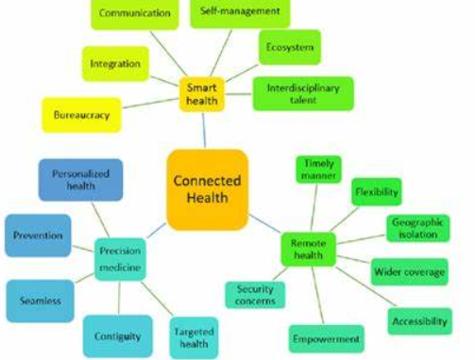
Thematic Analysis
Identifies themes / patterns in the data – how people make sense of something
Codes – short phrases /words used by the participant
Depth over breadth (rich and descriptive understanding)
Descriptive insight and subjective experiences, perceptions and emotion
Looks at latent meaning – underlying ideas, assumptions
Flexible and exploratory (typically no predefined categories)
Purely qual – no statistical/numerical values
Narrative / descriptive output
Typically, inductive (data-driven)
Findings / patterns are ‘created’ by researcher
Subjective / interpretation
Reflection

Slide 23
Content vs Thematic (when to use what)
Feature | Content Analysis | Thematic Analysis
Purpose | Quantify and categorise content. | To explore and interpret patterns of meaning.
Codes | Typically, manifest (explicit) content (but can also be latent) | Both semantic (explicit meaning) and latent (underlying meaning)
Coding approach | Often deductive (predefined categories) but can be inductive | Often inductive (finding themes) but can be deductive
Focus & Output | Counts, categories, trends | Meaning-making – themes, narratives, interpretations
Flexibility | Structured and replicable | Flexible and iterative
Subjectivity | Minimised | Embraced – acknowledges and seen as part of analysis
Reflection | Some – procedural (coding consistency, bias reduction) | Central (own assumptions, iterative thinking/creative, interpretation)

Slide 24
Thematic Analysis: Braun and Clarke’s SIX STEP MODEL
Data Familiarisation
Initial Coding generation
Search for Themes
Review of Themes
Theme Definition and labelling
Report writing
- read and immerse yourself in the data
- for each participant, select key points/phrases or words into ‘codes’
- merge all codes into groups (themes) which have the same concept / idea
- review and refine themes (merge, create, change delete etc.)
- define the essence of each theme - what does it capture? Give themes a label.
- disseminate

Slide 25
4. Activities: online content

Slide 26
The online content
You’re going to have a look at some real data by Dr Ben Alderson-Day et al. and have a look at doing some Content analysis!
Go to Ultra and work through the activity*
If you have time within your ‘online’ hour you should:
Prepare your understanding of Thematic analysis for Practical 4 (watch the videos or do the reading by Braun & Clark)
Read some of the recommended reading
*content warning

Slide 27
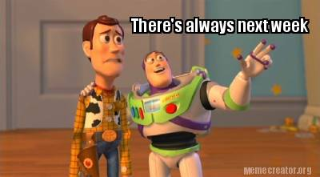
Do the online material for this week!
This will be important for Practical 4, where you’ll return to Qualitative research and run your own Thematic Analysis

